Slide 1




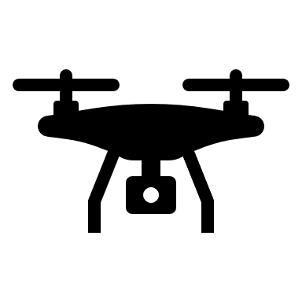
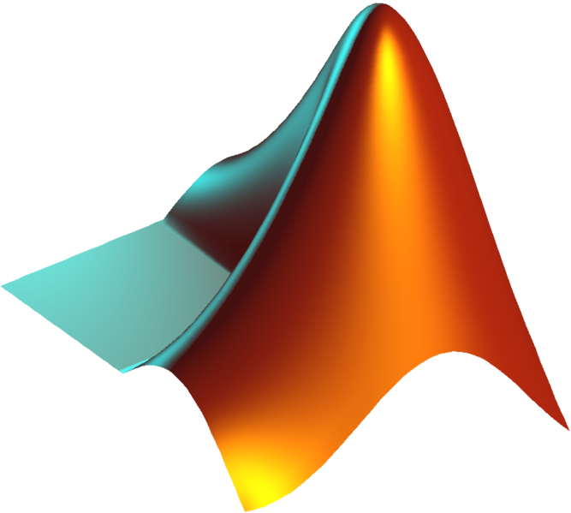
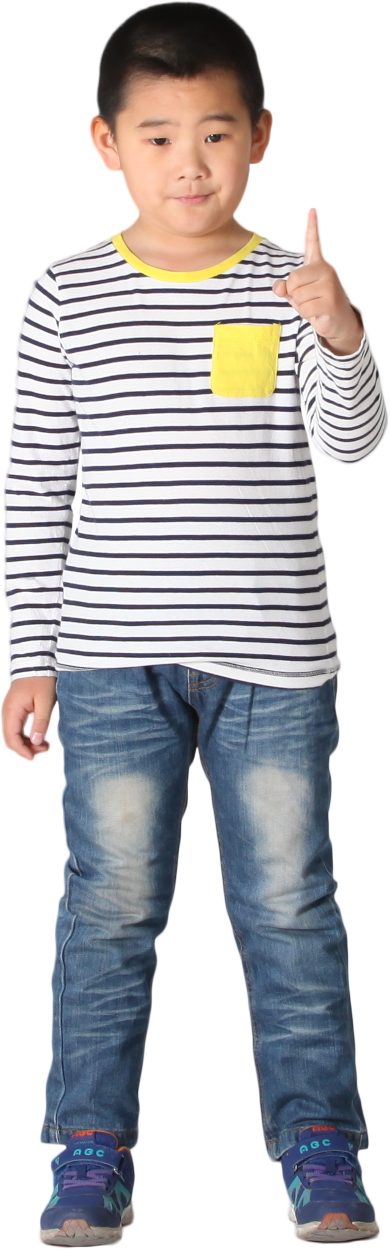
UAV controlled by hand signs
User hand sign
Camera
Raspberry
MQTT server
UAV
Give instruction with hand signs
Capture images
Detect hand in image
Receive instructions from computer
Subscribe to MQTT server
Send images to the Raspberry
Recognize hand signs
Send instructions to the client
Receive instructions
Publish instructions
Execute instructions

